Slide 1
Data science on subscription service
By: Chioma Charleen Egbuagha
Ladies Data Science Program April. 2023
GITHUB REPO LINK : …………………..

Slide 2
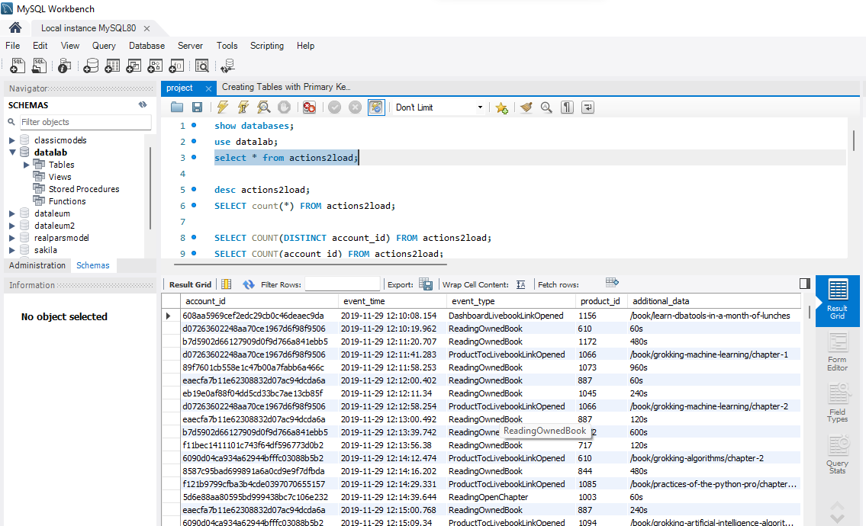
Load the Data into MYSQL Database

Slide 3
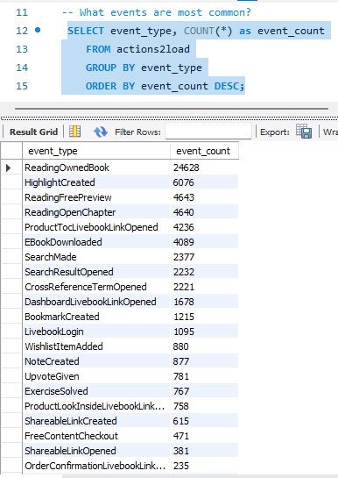
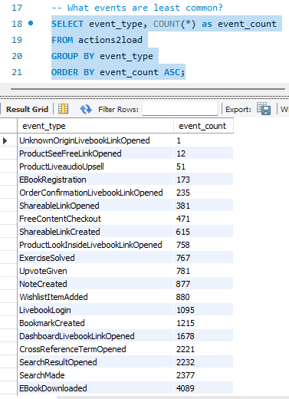
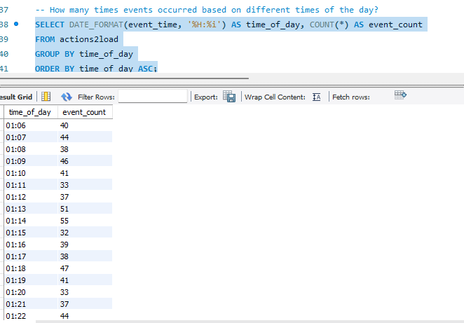
Use SQL for business Questions

Slide 4
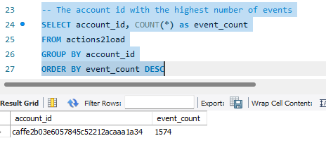
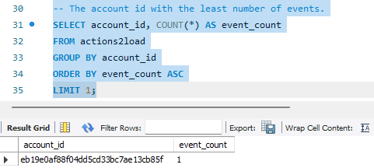
Use SQL for business Questions

Slide 5
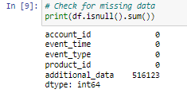
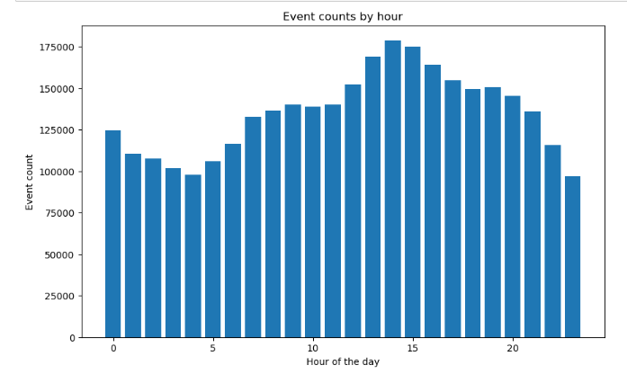
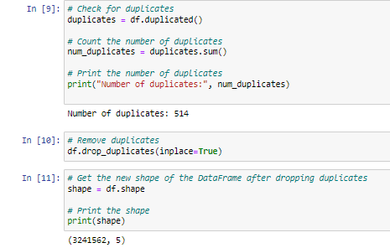
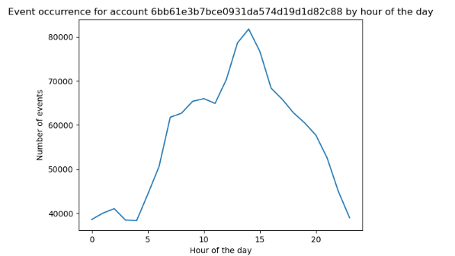
DATA QUALITY CHECK AND PATTERN RECOGNITION
The data called actions2load has a 3,242,076 rows and 5 columns.
Events do not happen equally at different times of the Day. Find Visualization on this slide.
Look at a display of Analysing an account ID For insights on how the person uses the service at different times of the day
There are missing data in the last column called additional column.

Slide 6
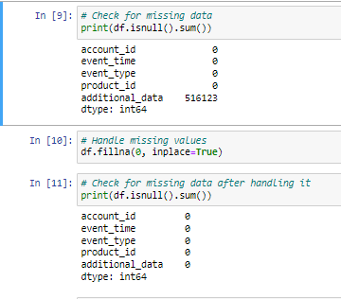
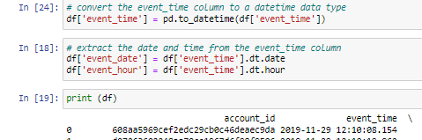
FIX BAD DATA
I Dropped the missing data in additional_data column.
I removed 514 duplicate Values from the dataset.
Afterward, the data had 3241562 rows and 5 columns
Fixed the timestamps for the “event_time” feature by converting to datetime data type. And also extracted the date and time from the event-time column.

Slide 7
